Slide 1


Agile vs.
Waterfall
Agile Presentation
Mohamad Darwiche
CS250 Software Development Lifecycle
10/17/2021
Shutterstock.com

Slide 2
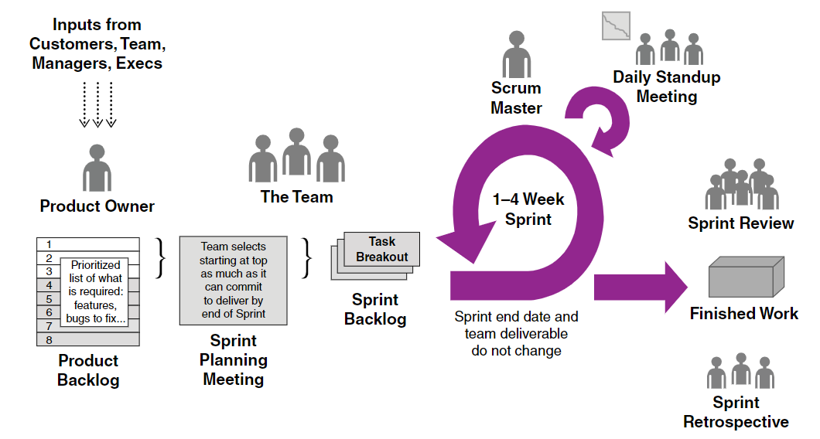
Scrum Framework
Charles G. Cobb. The Project Manager’s Guide to Mastering Agile : Principles and Practices for an Adaptive Approach. Wiley; 2015.
https://search-ebscohost-com.ezproxy.snhu.edu/login.aspx?direct=true&db=nlebk&AN=937009&site=ehost-live

Slide 3
Scrum Roles
Product Owner Role
The Product Owner is responsible for maximizing the value of the product and the work of the Development Team.
Scrum Master
The Scrum Master is responsible for ensuring Scrum is understood and enacted. Scrum Masters do this by ensuring that the Scrum Team adheres to Scrum theory, practices, and rules.
Development Team
The Development Team consists of professionals who do the work of delivering a potentially releasable increment of “Done” product at the end of each Sprint. Only members of the Development Team create the increment
Charles G. Cobb. The Project Manager’s Guide to Mastering Agile : Principles and Practices for an Adaptive Approach. Wiley; 2015.
https://search-ebscohost-com.ezproxy.snhu.edu/login.aspx?direct=true&db=nlebk&AN=937009&site=ehost-live

Slide 4
Scrum Events
Sprint Planning
The sprint planning meeting takes place prior to the beginning of every sprint. The product owner and the team to negotiate what stories will be taken into the sprint. Define the tasks that will be needed to implement the stories and to plan how those stories and tasks will be allocated among the members of the team.
Sprint Review
The sprint review is where the team presents the finished work to the product owner for his/her final review and approval. It is essentially a brief User Acceptance Test at the end of each sprint.
Sprint Retrospective
The sprint retrospective is an opportunity to review and discuss lessons learned at the end of the sprint where the team looks back, reflects on what went well and what didn’t go well, and identifies opportunities for process improvement in the next sprint.
Daily Standup
The Daily Standup is basically a check-in for everyone on the team to coordinate what’s going on, monitor progress, and to identify any obstacles that may be inhibiting progress.
Charles G. Cobb. The Project Manager’s Guide to Mastering Agile : Principles and Practices for an Adaptive Approach. Wiley; 2015.
https://search-ebscohost-com.ezproxy.snhu.edu/login.aspx?direct=true&db=nlebk&AN=937009&site=ehost-live

Slide 5
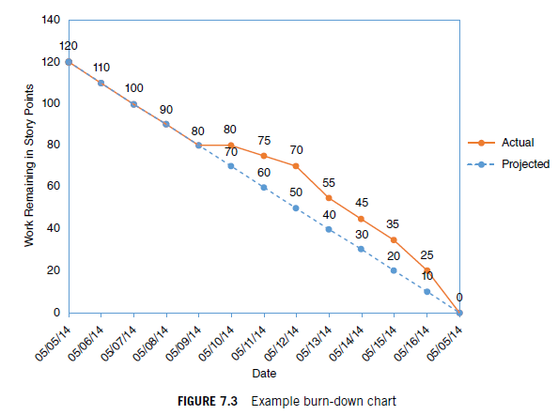
Scrum Approach
Product Backlog
The product backlog is a queue of the work to be done organized in the form of small increments
of work typically in the form of user stories.
Sprint Backlog
The sprint backlog consists of all items to be included in each sprint.
Burn-down charts
A burn-down chart is a chart often used in scrum agile development to track work completed against time allowed.
Charles G. Cobb. The Project Manager’s Guide to Mastering Agile : Principles and Practices for an Adaptive Approach. Wiley; 2015.
https://search-ebscohost-com.ezproxy.snhu.edu/login.aspx?direct=true&db=nlebk&AN=937009&site=ehost-live

Slide 6
Agile vs. Waterfall
Waterfall development model has some limitations that make it less adaptable than Agile. Agile provides a flexible and interactive model. In large projects, the concept of testing your code till the end might waste a lot of time. If all the elements are predefined and the structure is simple, the waterfall works well. Agile methodology has several advantages, including the ability to improve processes continuously and being less rigid than Waterfall.

Slide 7
References
Charles G. Cobb. The Project Manager’s Guide to Mastering Agile : Principles and Practices for an Adaptive Approach. Wiley; 2015.
https://search-ebscohost-com.ezproxy.snhu.edu/login.aspx?direct=true&db=nlebk&AN=937009&site=ehost-live

